Slide 1
Healthcare and medical technologies with ai
PRESENTATION BY- Gaurangi Gupta, Jinisha Chauhan, Lakshya Meghani
NAME OF THE PROJECT- AI Doctors
HACKATHON
PRESENTATION

Slide 2
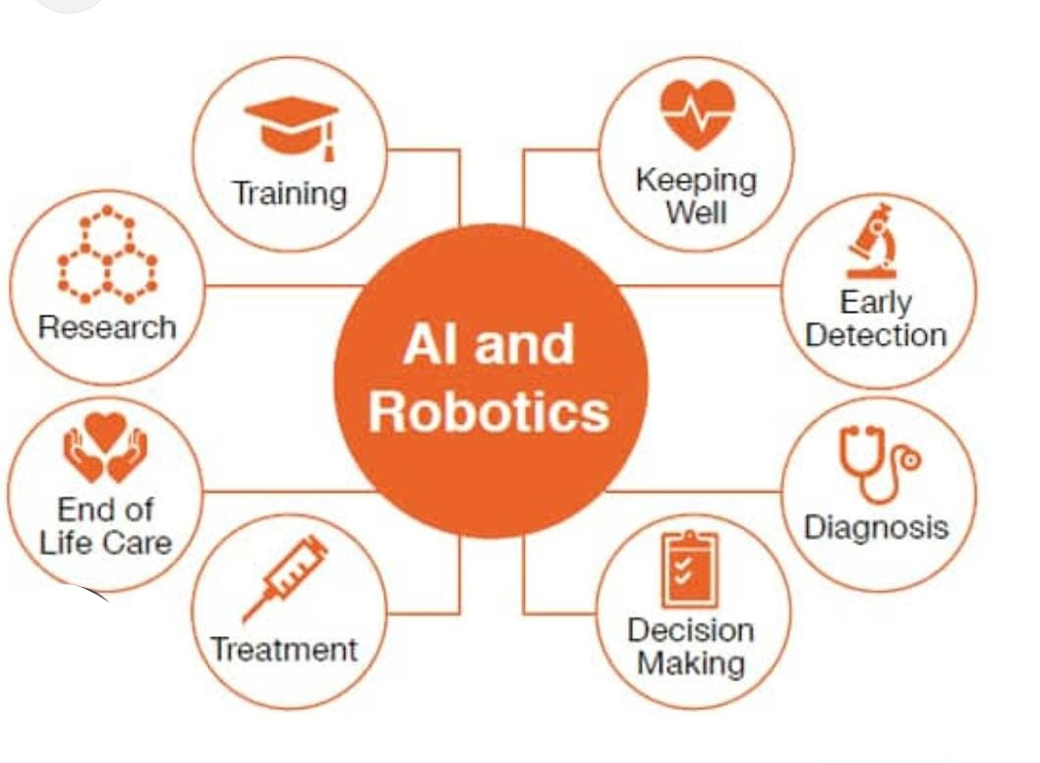
TECHNOLOGIES THAT CAN BE SUPPORTED BY AI
Research work done by AI/bots
Life care
Treatment for patients by bots
Support for keeping well
Detection of any new viruses/ diseases in patients or laboratories
Diagnosis of diseases/virus
Decision making for necessary medicines and healthcare

Slide 3
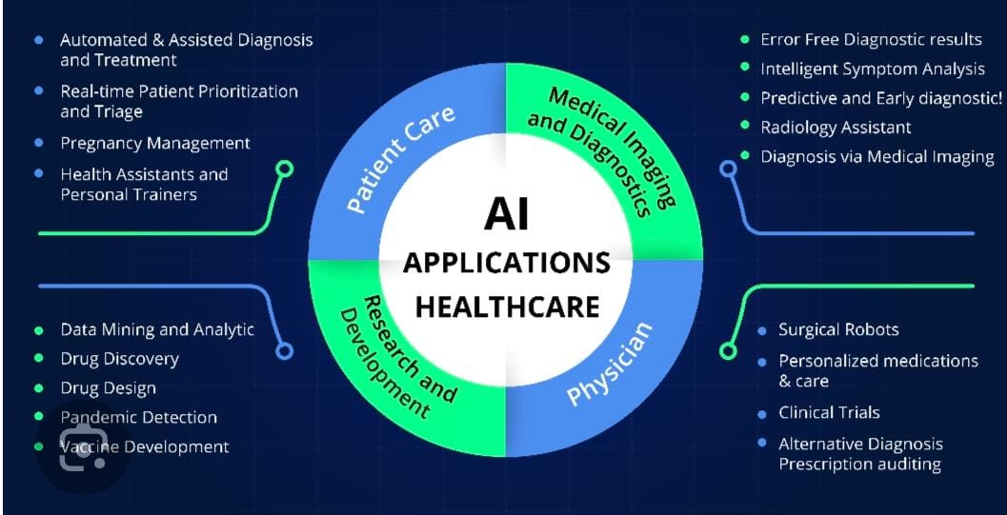
MORE APPLICATIONS OF AI

Slide 4
EXPLANATION
There are various uses of AI, robots and bots in healthcare and medical field.
If we take an example we can say that robots and bots can be used in finding out new diseases and viruses. They can also be used to find out new solutions to them. It can be done by installing some independent algorithm in them, by which they can understand and solve the case.
An algorithm is a set of instructions or commands in robots/computers that allow them to solve problems or calculations.
Also, they can be used for health and living care of humans. For example if a patient is admitted in hospital, a bot/robot can take care of them. By providing medicines on time, their checkups and they will also be available for them 24/7. This can reduce work pressure for humans and also will be a benefit for them.

Slide 5
